Slide 1

To make others never forget you:
Comment on some very personal and specific quality you spot in someone.
It is NOT like “I like your tie” or “You’re a very nice person.”
(The first is not personal enough and the second is not specific enough.) ,
but more like “What exquisite eyesyou have,” (very specific) or
“You have a wonderful air of honesty about you,” (very personal).

Slide 2

To make others smile:
Drop short and quick kudos(赞誉) into your casual conversation.
Let others know how much you appreciate them by caressing them like
“Nice job!” “Well done!” “Cool!”

Slide 3
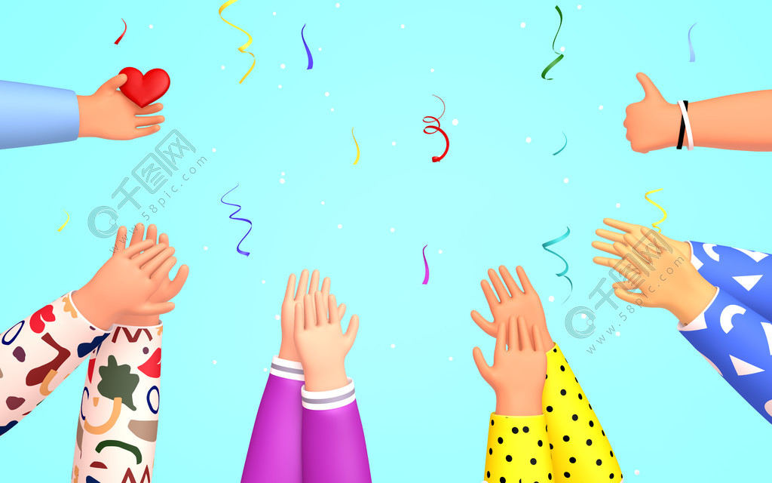
To prise with perfect timing:
Quick as a blink, you must praise people the moment they a finish a feat.
No matter whether their accomplishment is failed or triumphant,
you must praise it immediately.

Slide 4

To make others want to compliment you:
when someone tosses(献上) a compliment(赞扬) your way,
let the good feelings soar back to the tosser.
Don’t just say “Thanks.” (Or worse, “Oh it’s nothing.”)
Let them know of your gratitude and find a wayto compliment them for their compliment.

Slide 5

To make a loved one feel you are the partner for life:
Ask the important people in your life what they would like engraved on their tombstone. Chisel(刻进) it into your memory but don’t mention it again.
Then, when the moment is right to say “I appreciate you” or “I love you,” fill the blanks with the very words they gave you weeks earlier.
You take people’s breath away when you feed their deepest self-image to them in a compliment.
“At last,” they say to themselves, “someone who loves me for who I truly am.”

Slide 6
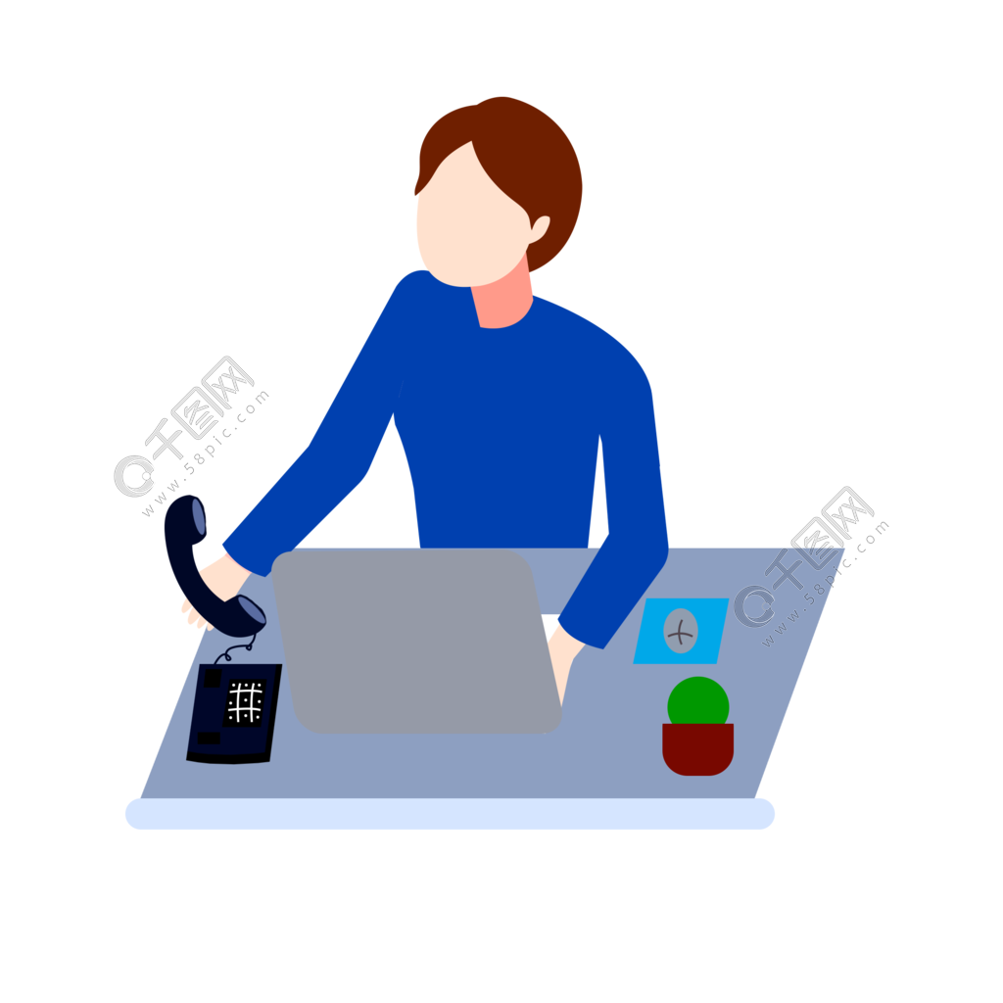
To sound more exciting on the phone:
If you want to comeacross as engaging as you are,
you must turn your smiles into sound, your nods into noise,
and all your gestures into something your listener can hear.
You must replace your gestures with talk.

Slide 7

To sound close:
People perk up(集中注意力) when they hear their own name.
Use it more often on the phone than you would in person to keep their attention.

Slide 8

To make others happy they called you:
Don’t answer the phone with an “I’m just sooo happy all the time” attitude. Answer warmly, crisply(爽快地), and professionally.
Then, after you hear who is calling,
let a huge smile of happiness engulf(布满) your entire face and
spill over into your voice.
You make your caller feel as though
your giant warm fuzzy smile is reserved for him or her.

Slide 9
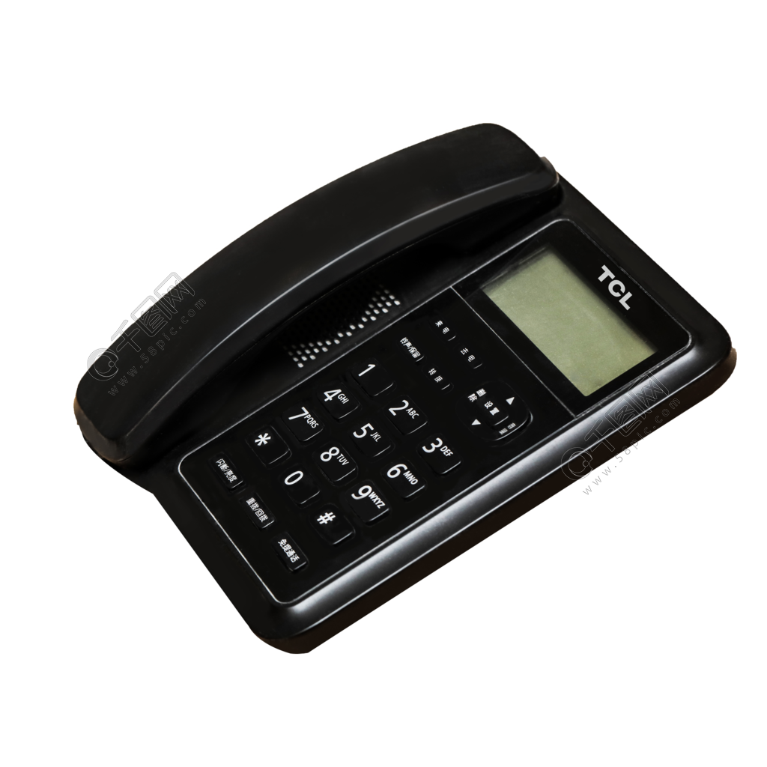
To screen your calls:
If you must screen(转接) your calls, instruct your staff to first say cheerfully,
“Oh yes, I’ll put you right through. May I tell her who’s calling?”
If the party has already identified himself,
it’s “Oh of course, sir. I’ll put you right through.”

Slide 10
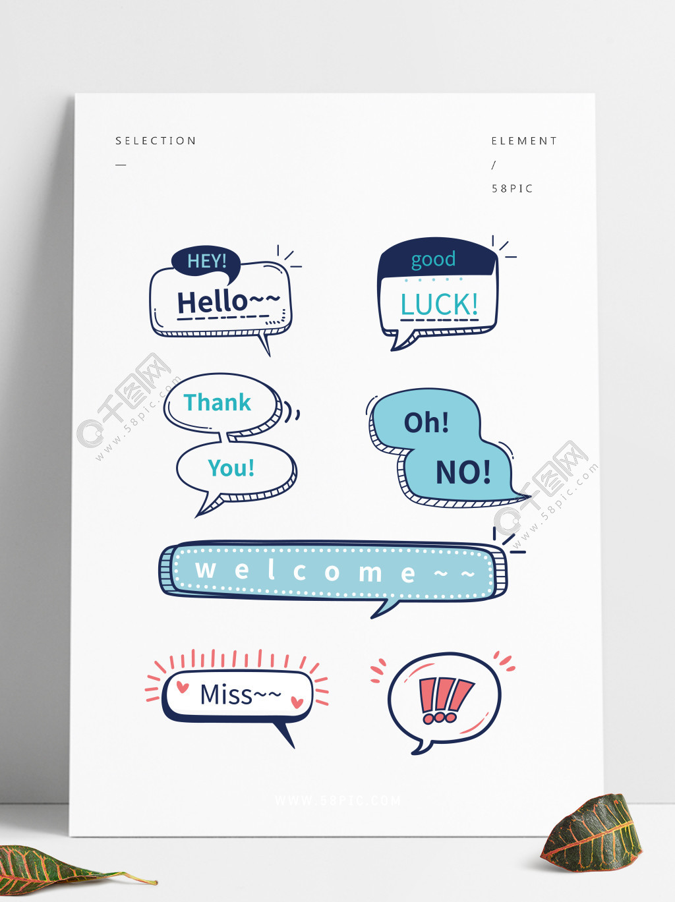
To get what you want on the phone:
Whenever you are calling someone’s home,
always identify and greet the person who answers.
Whenever you call someone’s office more than once or twice,
make friends with the secretary.
Anybody who is close enough to answer the phone
is close enough to sway the VIP’s opinion of you.

Slide 11

To get what you want by timing:
No matter how urgent you think your call,
always begin by asking the person about timing.
Simply ask, “Is this a convenient time for you to talk?”
When you ask about timing first,
you’ll never get a “No!” just because your timing wasn’t right.

Slide 12

To impress everyone with your message:
If you want to be perceived as conscientious(认真的) and reliable,
leave a short, professional, and friendly greeting as your outgoing message.
And change it every day.
Your message doesn’t have to be flawless(完美无缺).
A little cough or stammer(口吃) gives a lovely unpretentious reality to your message.

Slide 13

To make the gatekeeper think you’re VIP:
Instead of using your party’s name,
casually let the pronoun he or she roll off your tongue.
Forget “Uh,may I speak to Ms. Bigshot please?”
Just announce,“Hi, Bob Smith here, is she in?”
Tossing the familiar she off your tongue signals to the secretary that you and
her boss are old buddies.

Slide 14

To make them say you have super sensitivity:
When you hear a phone in the background, stop speaking,
if necessary—and say “I hear your other line,”
(or your dog barking, your babycrying, your spouse calling you).
Ask whether she has to attend to it.
If you do business with people around the world,
be sure to extend good wishes to them for their holidays.
Forget about your own if they’re not shared.
.

Slide 15

To listen on the phone:
Ask for a recorder for your telephone.
Then turn the recorder on during your next important conversation.
Record all your business conversations and listen to them again.
The second or third time, you pick up on significant subtleties
you missed the first time.
When we want something, our minds play funny tricks on us.
If we desperately crave “yes” from someone, we hear “yes.”
But “yes” isn’t always what it seems.

Slide 16

To enjoy the party:
Eat before you come to the party.
You’d need a talent to shake hands, exchange business cards, hold a drink,
and stuff crackers(塞入饼干) and cheese into your mouths—all with just two hands.

Slide 17

To make an unforgettable entrance:
Before entering, stop dramatically in the doorway and
survey the scene slowly with your eyes.
It is significant that, while you’re standing in the doorway,
you’re not thinking, “Look at me.”
Listen to the music, the buzz of the crowd, the clinking of glasses. See who is talking to whom. You’ll also be using “Be the Chooser, Not the Choosee,”

Slide 18

To meet the people you want to meet:
When you seek people’s special qualities by exploring their faces,
you will find them. If you want to walk out of any gathering with your life enhanced, spend time with people you choose,not just those who choose you.
Be choosey in who you pick. But don’t wait to be the choosee.

Slide 19

To attract people at a gathering:
Party goers are more comfortable approaching people who stand with an open body, arms uncrossed and hanging at their sides, legs slightly separated,
a slight smile on their faces.
When standing at a gathering, arrange your body in an open position
—especially your arms and hands.

